Slide 1


Slide 2


Git & GitHub
Faisal aslam

Slide 3
Job Opportunities
In this time all the companies and employers use GitHub to search for potential candidates.
Active and well-maintained GitHub profiles can help software engineers stand out in the job market.

Slide 4
Contents
Version Control
Git, Setup git environment , Configuration
Github, Repository/Git Repo
Create a git repository (Add Project)
Remote to Local
Local To Remote
Branches
Fork

Slide 5
Version Control System
Version control system is a tool that help to track changes in code.
Track project history.
Multiple developers/students are doing a project together.

Slide 6

Git
Git is a Version control system.
Created by Linus Torvalds , April 2005.
A command line version control program.
It is :
Popular
Free
Open source
Fast
Scalable
To tack history
Collaborate

Slide 7

GitHub
GitHub was developed by Chris Wanstrath, P. J. Hyett, and started in February 2008.
GitHub is a site for online storage of Git repositories.
A Website that allows developers to store and manage their code using Git.
https://github.com

Slide 8

Git vs GitHub
Git is the version control system itself, while GitHub is a platform or website that uses Git for version control and provides additional tools and features to facilitate collaboration and development.

Slide 9
Question:
Why not Google drive & One drive ????
Source code management vs file management

Slide 10
Setting Up Git
Visual Studio Code
Windows (Git Bash)
Mac Terminal
https://git-scm.com/
git --version

Slide 11
Configuring Git
git config --global user.name “your name”
git config --global user.email “your email”
git config --list

Slide 12
Basic Commands
ls
ls –a
cd
pwd
Date
etc

Slide 13
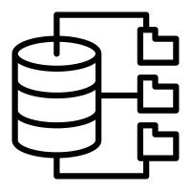
Repository
“Repo” = repository
Usually used to organize a single project.
Repo can contain folders and files, images, videos, and anything you project needs.

Slide 14
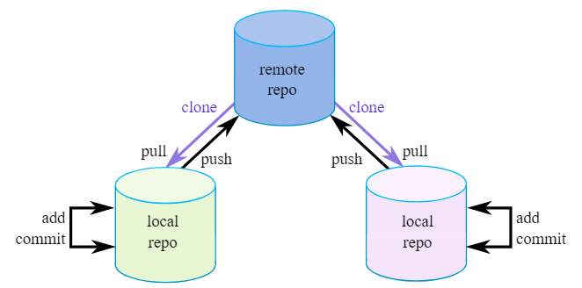
Types of Repo

Slide 15
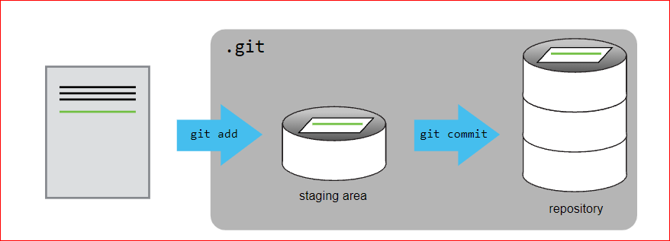
Adding file to Git Repository

Slide 16
Remote To Local

Slide 17
GitHub Account
Create new repository
Make our first commit

Slide 18
Clone and Status
Clone – Cloning a repository on our local machine
git clone <project-link>
Status – display the status of the code
git status

Slide 19
Changes
Untracked
New file that git doesn't yet track
Modified
changed
Staged
File is ready to be committed
Unmodified
Unchanged

Slide 20
Add & Commit
Add - add new or changed file in your working directory to the git staging area.
git add “file name”
git add .
Commit – it is the record of changes
git commit –m “some message”

Slide 21
Push
Push – upload local repo content to remote repo
git push origin main

Slide 22
Local To Remote

Slide 23
Init
git init
git add
git commit -m
git remote add origin <link>
git remote –v (verify remote)
git branch (show branches)
git branch -M main (rename the branch)
git push origin main

Slide 24
Work Flow
Remote to Local Local to Remote
Create repo git init
Clone changes
Changes add
Add commit
Commit create repo
Push link repo
branch rename (optional)
push

Slide 25
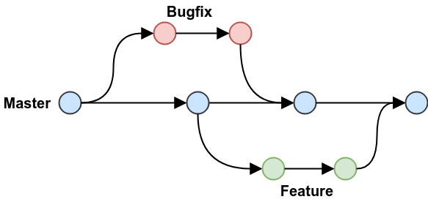
Branches

Slide 26
Branch Commands
git branch (show branches)
git branch -M main (rename the branch)
git checkout -b <branch-name> (new branch name)
git checkout <branch-name> (to navigate)
git branch -d <branch-name> (to delete the branch)

Slide 27
Merge the Branches
Way 1
git merge <branch-name>
Way 2
Create a PR

Slide 28
Pull Request
It lets you tell others about changes you've pushed to a branch in a repository on GitHub.

Slide 29
Pull Command
Used to fetch and download content from a remote repo and immediately update the local repo to match that content.
git pull origin main

Slide 30
Fork
A fork is a new repository that shares code and visibility settings with the original "upstream" repository.
Fork is a rough copy.

Slide 31


Any Questions

